Slide 1

COE STARTER KIT - SETUP

Slide 2
What identity should I install the CoE Starter Kit with?

Slide 3
The CoE Starter Kit requires access to your tenant's Power Platform environments.
Microsoft Power Platform service admin,
Global tenant admin
Dynamics 365 service admin.
Power Apps Per User license (non-trial) and Microsoft 365 license.
Power Automate Per User license, or Per Flow licenses (non-trial).
Power BI Premium per user or per capacity (if using Data Export for inventory)
The identity must have access to an Office 365 mailbox that has the REST API enabled. It must also meet all requirements to use the Office 365 Outlook connector.
If you'd like to collect usage information, such as app launches and unique users per app, you must have access to an Azure app registration.
The app registrations needs to have permissions to read data from the Microsoft 365 audit log to complete the setup. You only need this app registration if you are using Cloud flows for inventory.
If you'd like to share the Power BI report that's part of the CoE Starter Kit, this identity needs to have the Power BI Pro license.

Slide 4
Create Microsoft 365 Groups

Slide 5
You should consider how you communicate with different groups of people before you start the setup.
Power Platform needs to have these 3 Persona:
Admin persona
Power Platform admins to communicate with each other.
Power Platform makers to contact Power Platform admins.
Maker persona
Power Platform admins to contact Power Platform makers.
Power Platform makers to communicate with each other.
User persona
Power Platform admins to contact Power Platform users.
3 Microsoft Groups , email enabled security groups (in Admin Center)

Slide 6
Type of Environment to install CoE Starter Kit

Slide 7
PRODUCTION ENVIRONMENT
Create an environment with Database
No need to sample data / Apps
No Security group to be added

Slide 8
CHECK DLP Policies and Have these connectors
Approvals
Azure Resource Manager
HTTP with Microsoft Entra ID
Dataverse
Dataverse (Legacy)
Microsoft Teams
Office 365 Groups
Office 365 Outlook
Office 365 Users
PowerApps for Admin
PowerApps for Makers
Power Automate for Admin
Power Automate Management
Power Platform for Admin
Power Query Dataflows
RSS
SharePoint

Slide 9
Download CoE Starter Kit
https://aka.ms/coeStarterkit

Slide 10
ENVIRONMENT VARIABLES
Variable | DETAILS
Admin eMail | This is the email address to which most admin communications in the starter kit are sent
CompanyName | The name of the company to be displayed in various apps, emails, and so forth. Currently only used by the Video hub (Nurture components) app.
Individual Admin | This is the email address to which communications in the starter kit are sent which can't be sent to a group.
Power Platform Maker Microsoft 365 Group | Get the ID of the Microsoft 365 group, which contains all your Power Platform makers
Power Platform User Microsoft 365 Group | Get the ID of the Microsoft 365 group, which contains all your Power Platform users (for example, end users that apps are shared with).
Graph URL Environment Variable | The URL used to connect to Microsoft Graph. For an environment in the commercial cloud: https://graph.microsoft.com/
PowerApp Maker environment variable | https://make.powerapps.com/
PowerApp Player environment variable | https://apps.powerapps.com/
Power Automate environment variable | https://make.powerautomate.com/environments/
TenantID | Your Azure tenant ID.

Slide 11
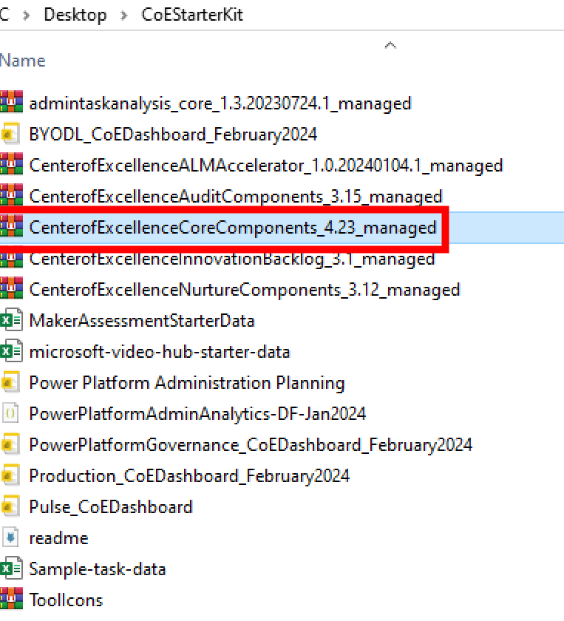
IMPORT Core Component Solutions

Slide 12
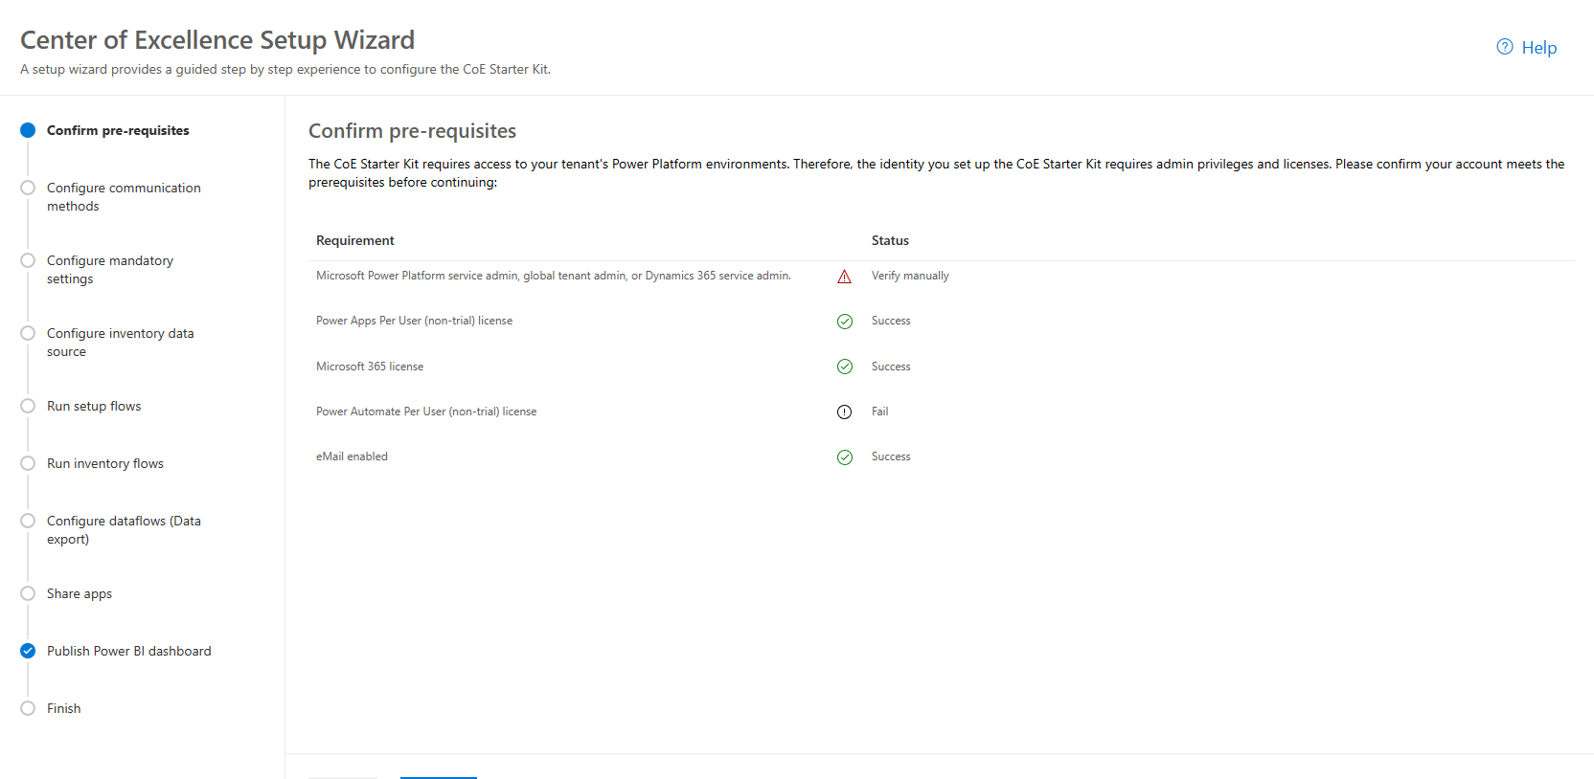
Open the Setup Wizard to complete the configuration
After the solution import is successful, open the Center of Excellence - Core Components solution.
Open the CoE Setup and Upgrade Wizard app.
This app provides a guided step-by-step experience through the configuration steps.

Slide 13
CoE Starter Kit Component Setup
Inside Solution – Flows – these flows to be Turned on
There are several child flows. Check to make sure all these flows are on:
HELPER - Add User to Security Role
HELPER - Send Email
HELPER - Maker Check
HELPER - CloudFlowOperations
HELPER - CanvasAppOperations
HELPER - ObjectOperations
CLEANUP HELPER - Check Deleted (Ai Models)
CLEANUP HELPER - Check Deleted (Business Process Flows)
CLEANUP HELPER - Check Deleted (Canvas Apps)
CLEANUP HELPER - Check Deleted (Cloud Flows)
CLEANUP HELPER - Check Deleted (Custom Connectors)
CLEANUP HELPER - Check Deleted (Model Driven Apps)
CLEANUP HELPER - Check Deleted (PVA)
CLEANUP HELPER - Check Deleted (Solutions)
CLEANUP HELPER - Power Apps User Shared With
SYNC HELPER - Apps
SYNC HELPER - Cloud Flows
SYNC HELPER - Get Security Role Users

Slide 14
CoE Starter Kit Component Setup
Turn on setup flows
The following flows support the inventory setup and need to be turned on before proceeding:
Admin | Sync Template v3 CoE Solution Metadata
Admin | Sync Template v3 Configure Emails
Admin | Sync Template v3 (Connectors)
Admin | Add Maker to Group
Admin | Excuse Non Inventoried Envts from Governance Flows
Admin | Excuse Support Envts from Governance Flows
Command Center App > Get M365 Service Messages
Command Center App > Initially Populate Bookmarks
Command Center App > Set CoE Flows State
DLP Editor > Parse impacted resources into CSV

Slide 15
Important
Before proceeding, ensure that these flows run and complete successfully, one by one:
Admin | Sync Template v3 CoE Solution Metadata
Admin | Sync Template v3 Configure Emails
Admin | Sync Template v3 (Connectors)

Slide 16
CoE Starter Kit Component Setup
Turn on inventory flows
Admin | Sync Template v3 (Ai Models)
Admin | Sync Template v4 (Apps)
Admin | Sync Template v3 (Business Process Flows)
Admin | Sync Template v3 (Connection Identities)
Admin | Sync Template v3 (Custom Connectors)
Admin | Sync Template v3 (Desktop Flow - Runs)
Admin | Sync Template v3 (Desktop flows)
Admin | Sync Template v3 (Environment Properties)
(optional) Admin | Sync Template v3 (Flow Action Details)
Admin | Sync Template v4 (Flows)
Admin | Sync Template v3 (Model Driven Apps)
Admin | Sync Template v3 (Portals)
Admin | Sync Template v3 (PVA)
Admin | Sync Template v3 (PVA Usage)
Admin | Sync Template v3 (Solutions)
Admin | Sync Template v3 (Sync Flow Errors)
Admin | Sync Template v3 (Driver)
CLEANUP - Admin | Sync Template v3 (Check Deleted)
CLEANUP - Admin | Sync Template v3 (Delete Bad Data)
CLEANUP - Admin | Sync Template v3 (Orphaned Makers)
CLEANUP - Admin | Sync Template v3 (Power Apps User Shared With)
CLEANUP - Admin | Sync Template v3 (PVA Usage)
Admin | Sync Template v3 (Call Updates)

Slide 17
CoE Starter Kit Component Setup
Microsoft Message Center

Slide 18
CoE Starter Kit Component Setup
Copy Azure Storage Account URL
https://learn.microsoft.com/en-us/power-platform/guidance/coe/setup-core-components#copy-azure-storage-account-url

Slide 19
CoE Starter Kit Component Setup
Copy Environment Web API endpoint
https://learn.microsoft.com/en-us/power-platform/guidance/coe/setup-core-components#copy-environment-web-api-endpoint

Slide 20
CoE Starter Kit Component Setup
Configure connections to data sources
https://learn.microsoft.com/en-us/power-platform/guidance/coe/setup-core-components#configure-connections-to-data-sources

Slide 21
CoE Starter Kit Component Setup
Configure Scheduled Refresh
Set up inventory components - Power Platform | Microsoft Learnhttps://learn.microsoft.com/en-us/power-platform/guidance/coe/setup-core-components#configure-scheduled-refresh

Slide 22
Set up the CoE Admin Command Center app

Slide 23
CoE Starter Kit Component Setup
Create a Microsoft Entra app registration to connect to Microsoft Graph
Set up inventory components - Power Platform | Microsoft Learnhttps://learn.microsoft.com/en-us/power-platform/guidance/coe/setup-core-components#create-a-microsoft-entra-app-registration-to-connect-to-microsoft-graph

Slide 24
Set up the Environment request components using the Setup Wizard
Open the Center of Excellence - Core Components solution.
Open the CoE Setup and Upgrade Wizard app.
Open the More features page and select Environment Request management.
This app provides a guided step by step experience through the configuration steps.

Slide 25
TURN ON RESPECTIVE FLOWS
DLP Request | Apply Policy to Environment (Child)
DLP Request | Sync Policy to Dataverse (Child)
DLP Request | Process Approved Policy Change
DLP Request | Sync new Policy
DLP Request | Sync Shared Policies
Env Request | Cleanup environments
Env Request | Create approved environment
Env Request | Notify admin when new request submitted
Env Request | Notify requestor when rejected

Slide 26
Set up other core components using the Setup Wizard
Open the Center of Excellence - Core Components solution.
Open the CoE Setup and Upgrade Wizard app.
Open the More features page and select Capacity alerts and Welcome email.
This app provides a guided step by step experience through the configuration steps.
This will give an option to send welcome mails to the Makers when they make their environments
There are several flows which will need to be turned on for these components:
Admin | Capacity Alerts
Admin | Add-Ons Alerts
Admin | Welcome Email v3
App Catalog > Request Access

Slide 27
Setting up the governance components

Slide 28
Initialize flow approval tables in your environment
Go to Power Automate and select your CoE environment.
Select + Create.
Select Instant cloud flow.
Pick manually trigger a flow as the trigger, and enter Admin | Dummy Approval Flow as the name
For next step click on this link

Slide 29
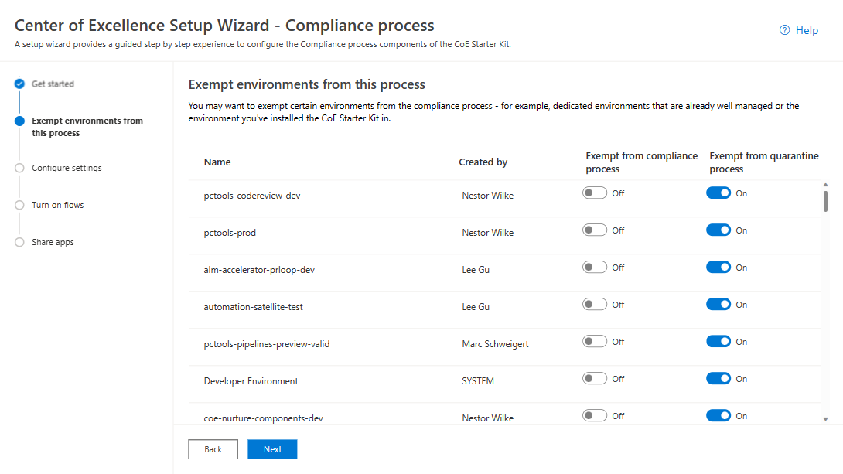
Set up Developer Compliance components
Open the Center of Excellence - Core Components solution.
Open the CoE Setup and Upgrade Wizard app.
Open the More features page and select Compliance process.
This app provides a guided step by step experience through the configuration steps.

Slide 30
Exempt environments from the compliance process
You may want to exempt certain environments from the compliance process
You can exempt environments from the compliance process using the Power Platform Admin View app.
Go to make.powerapps.com.
Go to your CoE environment.
Open the Power Platform Admin View app.
Select Environments > Chose the environment you want to exempt > Set the Excuse From Compliance Flows field to Yes > Save

Slide 31
Turn on flows
Turn on these flows that are installed as part of the Core components solution:
Admin | Compliance request complete apps v3
Admin | Compliance request complete bots v3
Admin | Compliance request complete custom connector v3
Admin | Compliance request complete flows v3
Admin | Compliance Teams Environment BPF kickoff v3
Admin | Compliance Details Request eMail (Apps)
Admin | Compliance Details Request eMail (Chatbots)
Admin | Compliance Details Request eMail (Custom Connectors)
Admin | Compliance Details Request eMail (Desktop Flows)
Admin | Compliance Details Request eMail (Flows)
Admin | Compliance detail request v3

Slide 32
Set up inactivity processes

Slide 33
Set up the Inactivity process components using the Setup Wizard

Slide 34
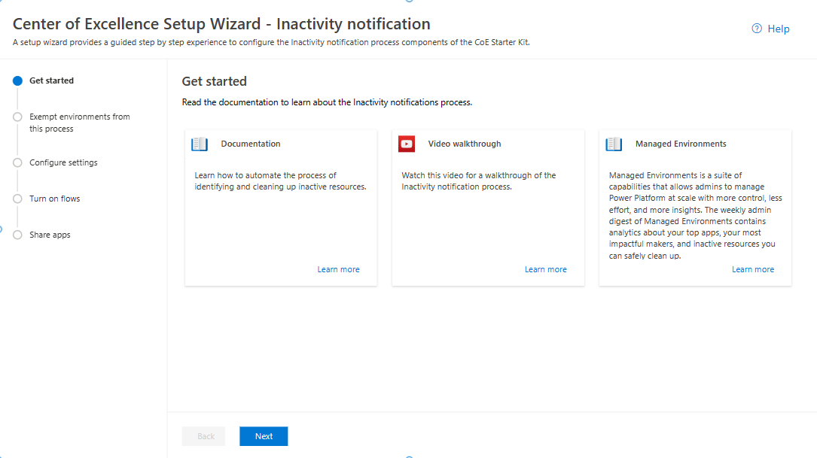
Open the Center of Excellence - Core Components solution.
Open the CoE Setup and Upgrade Wizard app.
Open the More features page and select Inactivity notifications process.
This app provides a guided step by step experience through the configuration steps.

Slide 35
Set up clean-up for orphaned objects

Slide 36
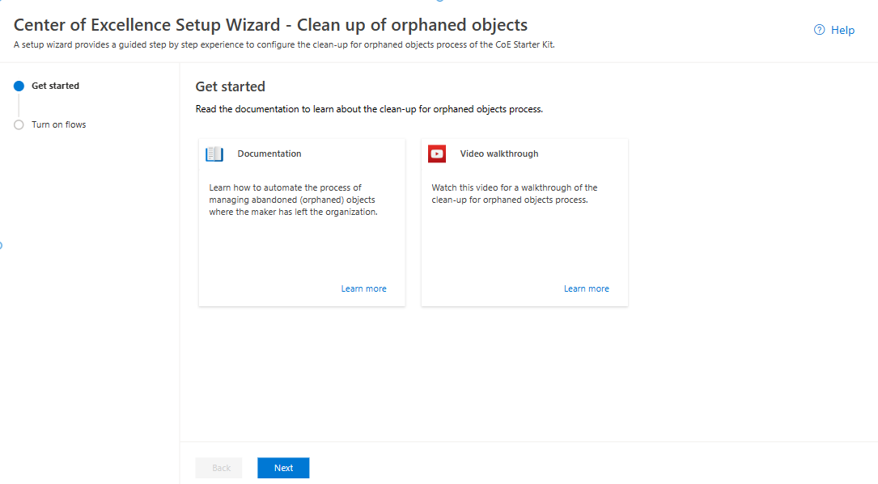
Set up the Clean-up for orphaned objects components using the Setup Wizard
Open the Center of Excellence - Core Components solution.
Open the CoE Setup and Upgrade Wizard app.
Open the More features page and select Clean-up for orphaned resources.
This app provides a guided step by step experience through the configuration steps.

Slide 37
Set up app quarantine components
Open the Center of Excellence - Core Components solution.
Open the CoE Setup and Upgrade Wizard app.
Open the More features page and select Compliance process.
This app provides a guided step by step experience through the configuration steps.

Slide 38
Set up the Power BI dashboard

Slide 39
Which dashboard to use?
You can get the CoE Power BI dashboard by downloading the CoE Starter Kit compressed file (aka.ms/CoeStarterKitDownload). Extract the zip file after downloading - it contains two Power BI template files:
Use the Production_CoEDashboard_MMMYY.pbit file if your Power Platform inventory data source is retrieved via cloud flows.
Use the BYODL_CoEDashboard_MMMYY.pbit file if your Power Platform inventory data source is retrieved via Data Export.
Use the PowerPlatformGovernance_CoEDashboard_MMMYY.pbit file in addition to the above dashboards to gain further actionable governance and compliance insights into your adoption.

Slide 40
Configure the Production and Governance Power BI dashboard
Use the
Production_CoEDashboard_MMMYY.pbit
file if your Power Platform inventory data source is retrieved via cloud flows.
Open the File in Power BI Desktop
Provide the COE kit Environment URL

Slide 41
Configure the BYODL Power BI dashboard

Slide 42
Configure the BYODL Power BI dashboard
Copy Azure Storage Account URL
Navigate to portal.azure.com.
Search for or select the storage account configured to receive Data Export data.
Select Endpoints.
Copy the Data Lake Storage URL to notepad.

Slide 43
Import Power BI dataflows
Configure Production and Governance Dashboard
Follow above link

